Slide 1
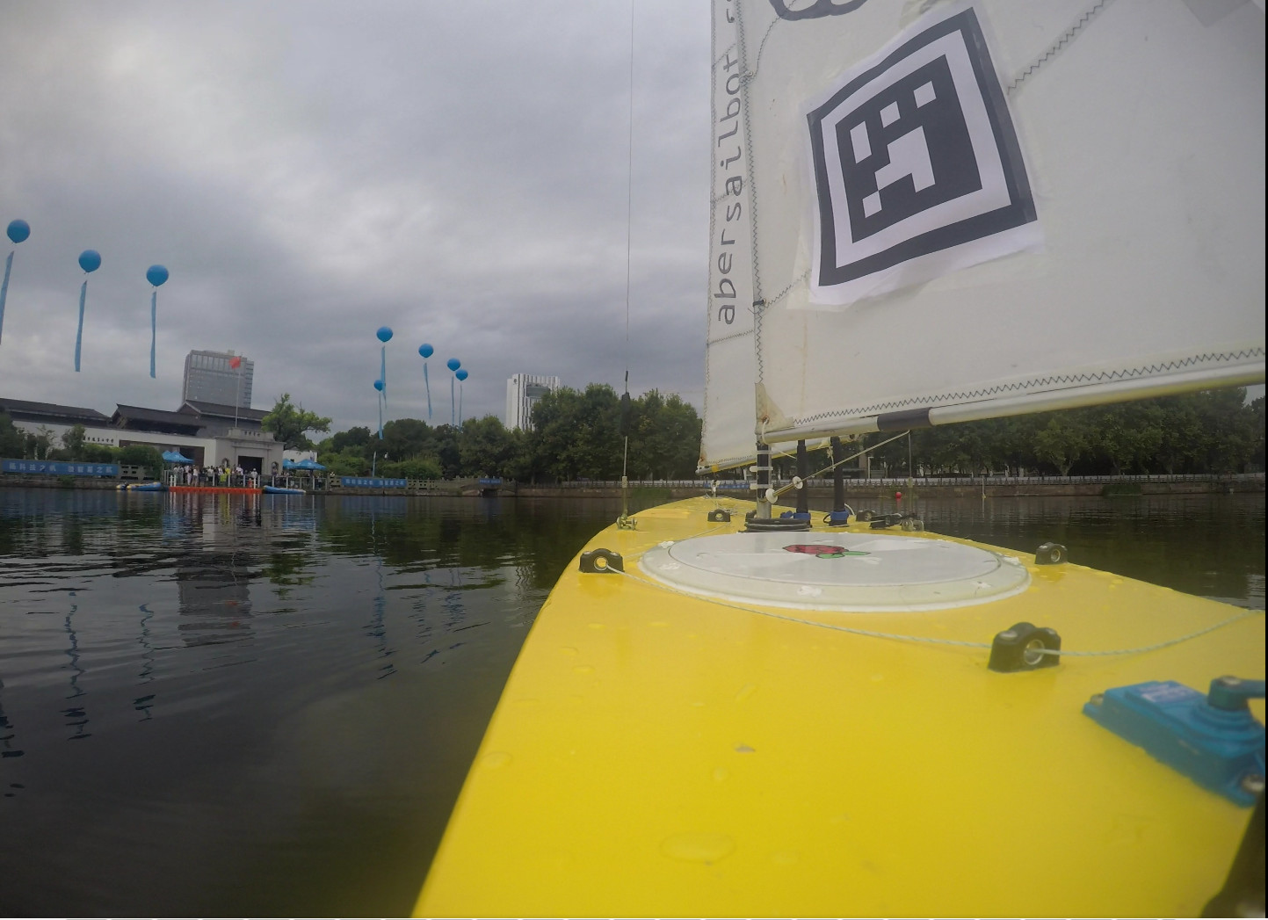

Notes:
---Lizzie---
Introduction

Slide 2
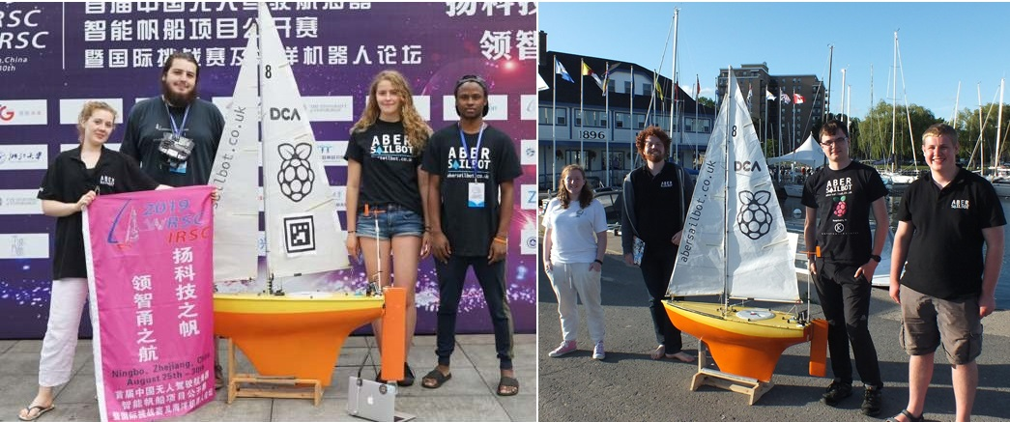



The Team
fb.com/abersailbot @abersailbot sailbot@aber.ac.uk
Notes:
We are AberSailbot!
Student led
Few members
Want more to join

Slide 3
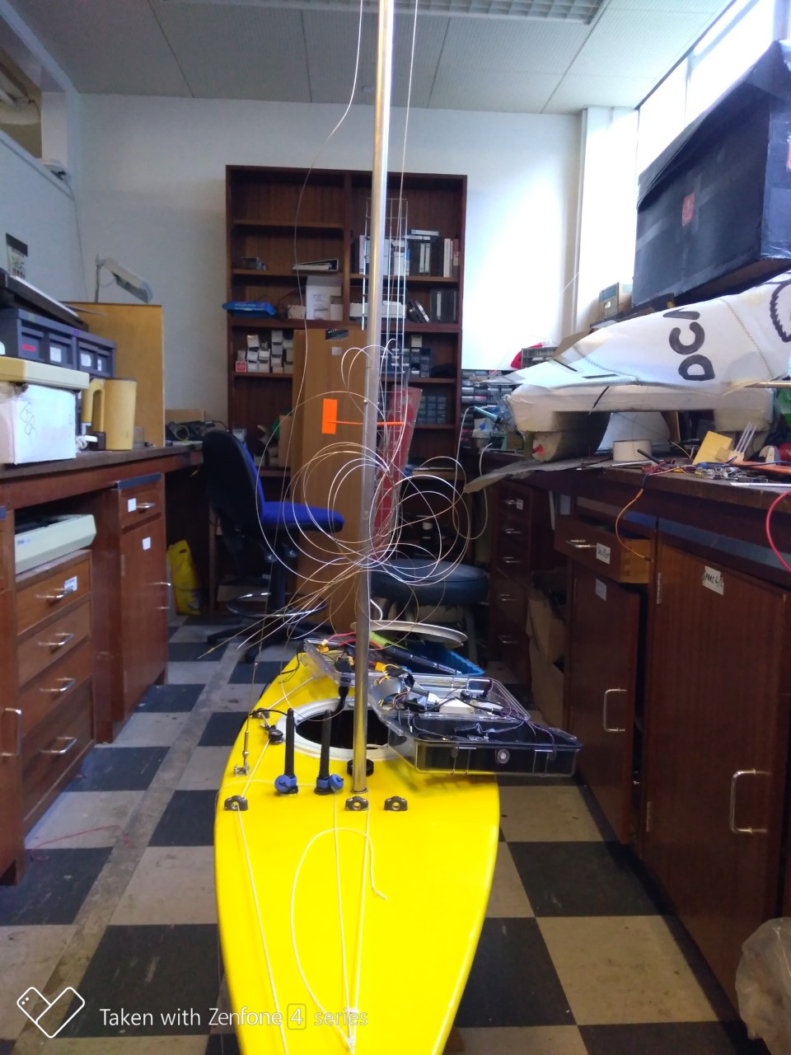
What do we do?
Build Autonomous Robotic Sailing Boats
Write code
Solve the ton of issues that we find/create
Go to competitions
Show the public what we do
Have fun
fb.com/abersailbot @abersailbot sailbot@aber.ac.uk
Notes:
Robotic Boats
RC and Sail Themselves
Code (boatd etc)
Competitions
Microtransat
Not alone - community of people

Slide 4
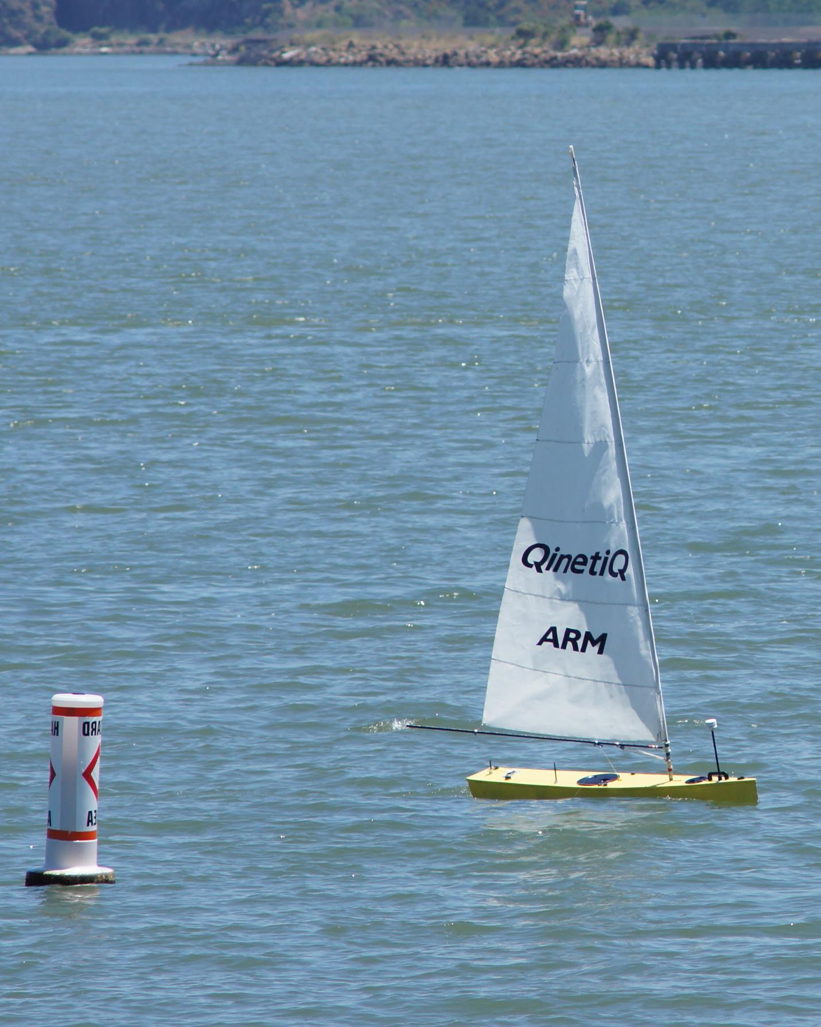
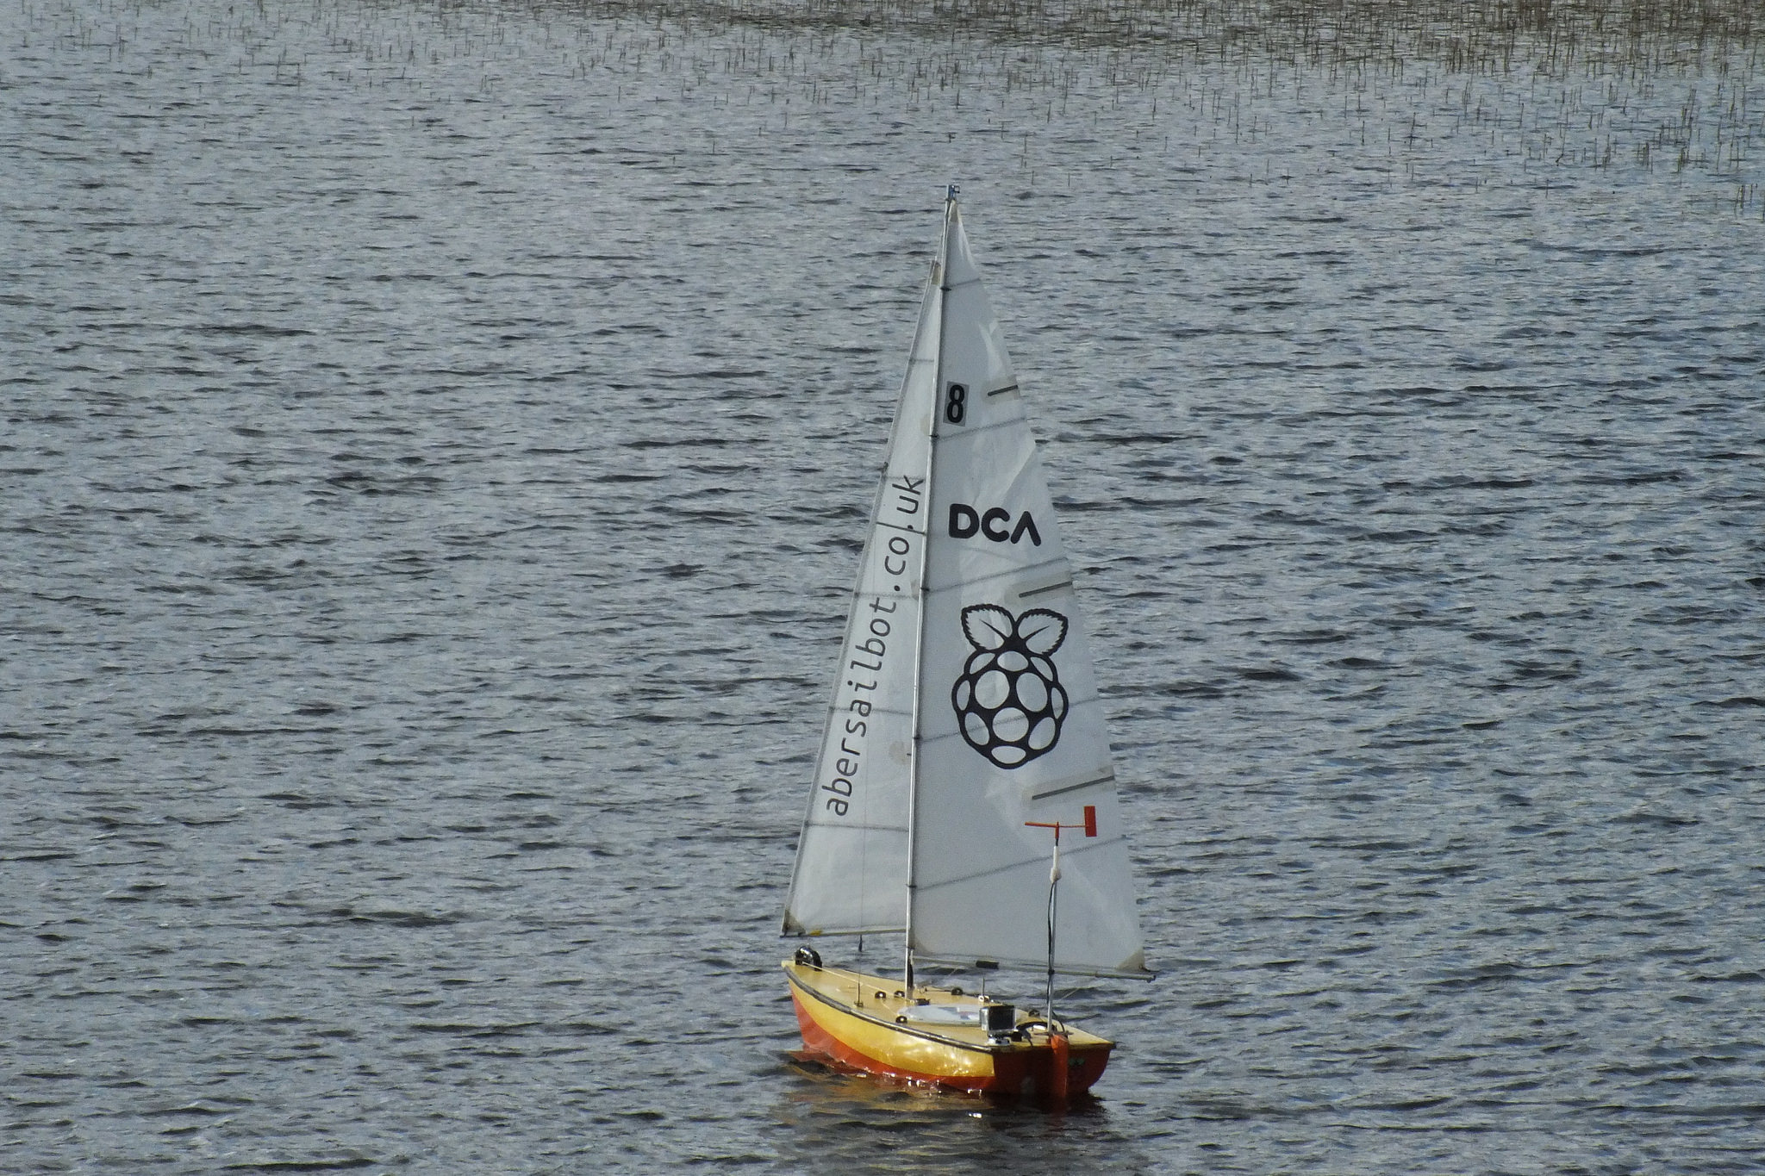
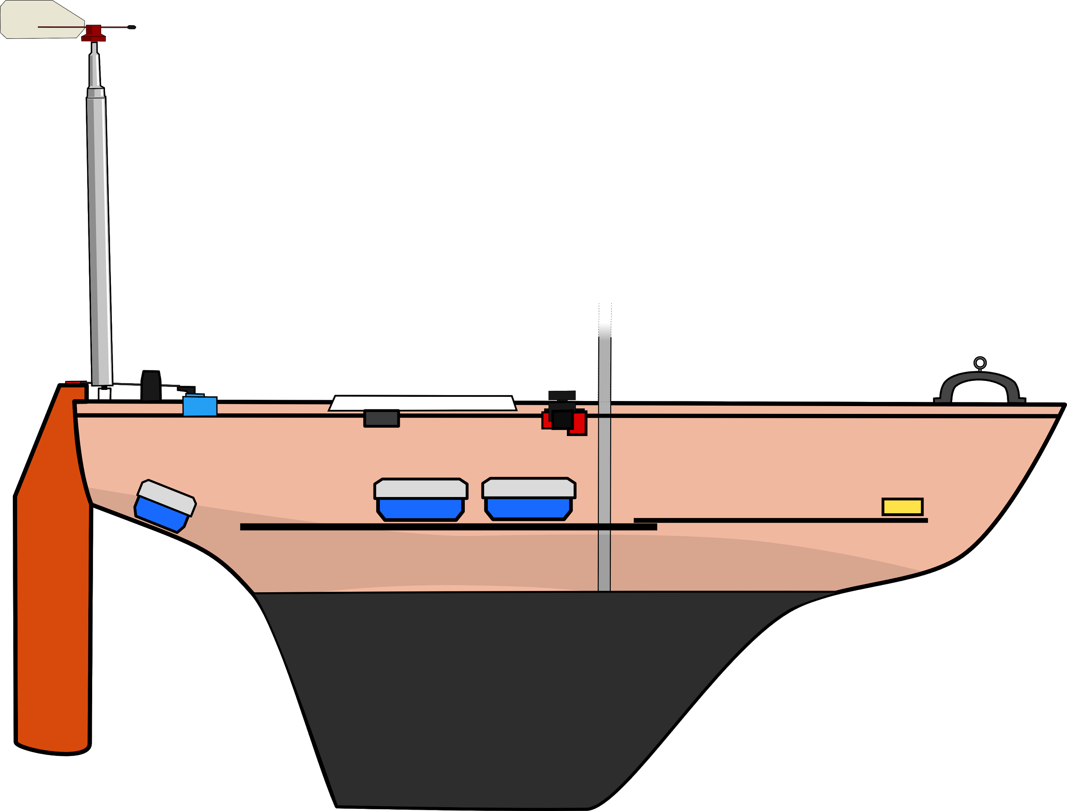
The Boats
Dewi’r Ddraig
Kitty
fb.com/abersailbot @abersailbot sailbot@aber.ac.uk
Notes:
Dewi’r Ddraig
Facts
Main and Jib
Maxi-MOOP hull - Paul Miller
1.2M, not the fastest, strong wind
Stable & reliable
New
Wind Sensor - dept design (rotary encoder)
Handle
Storm Sails
Electronics…
We have a simulator...
Kitty
Still work to be done
Needs new sail
Boat much larger
Detachable keel

Slide 5
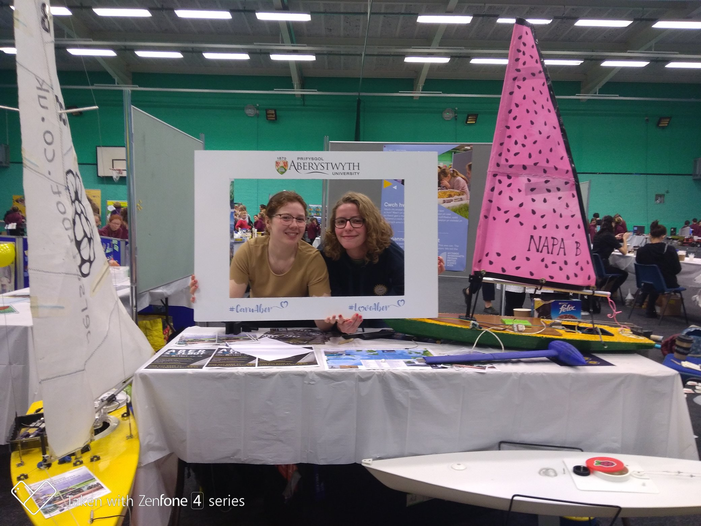
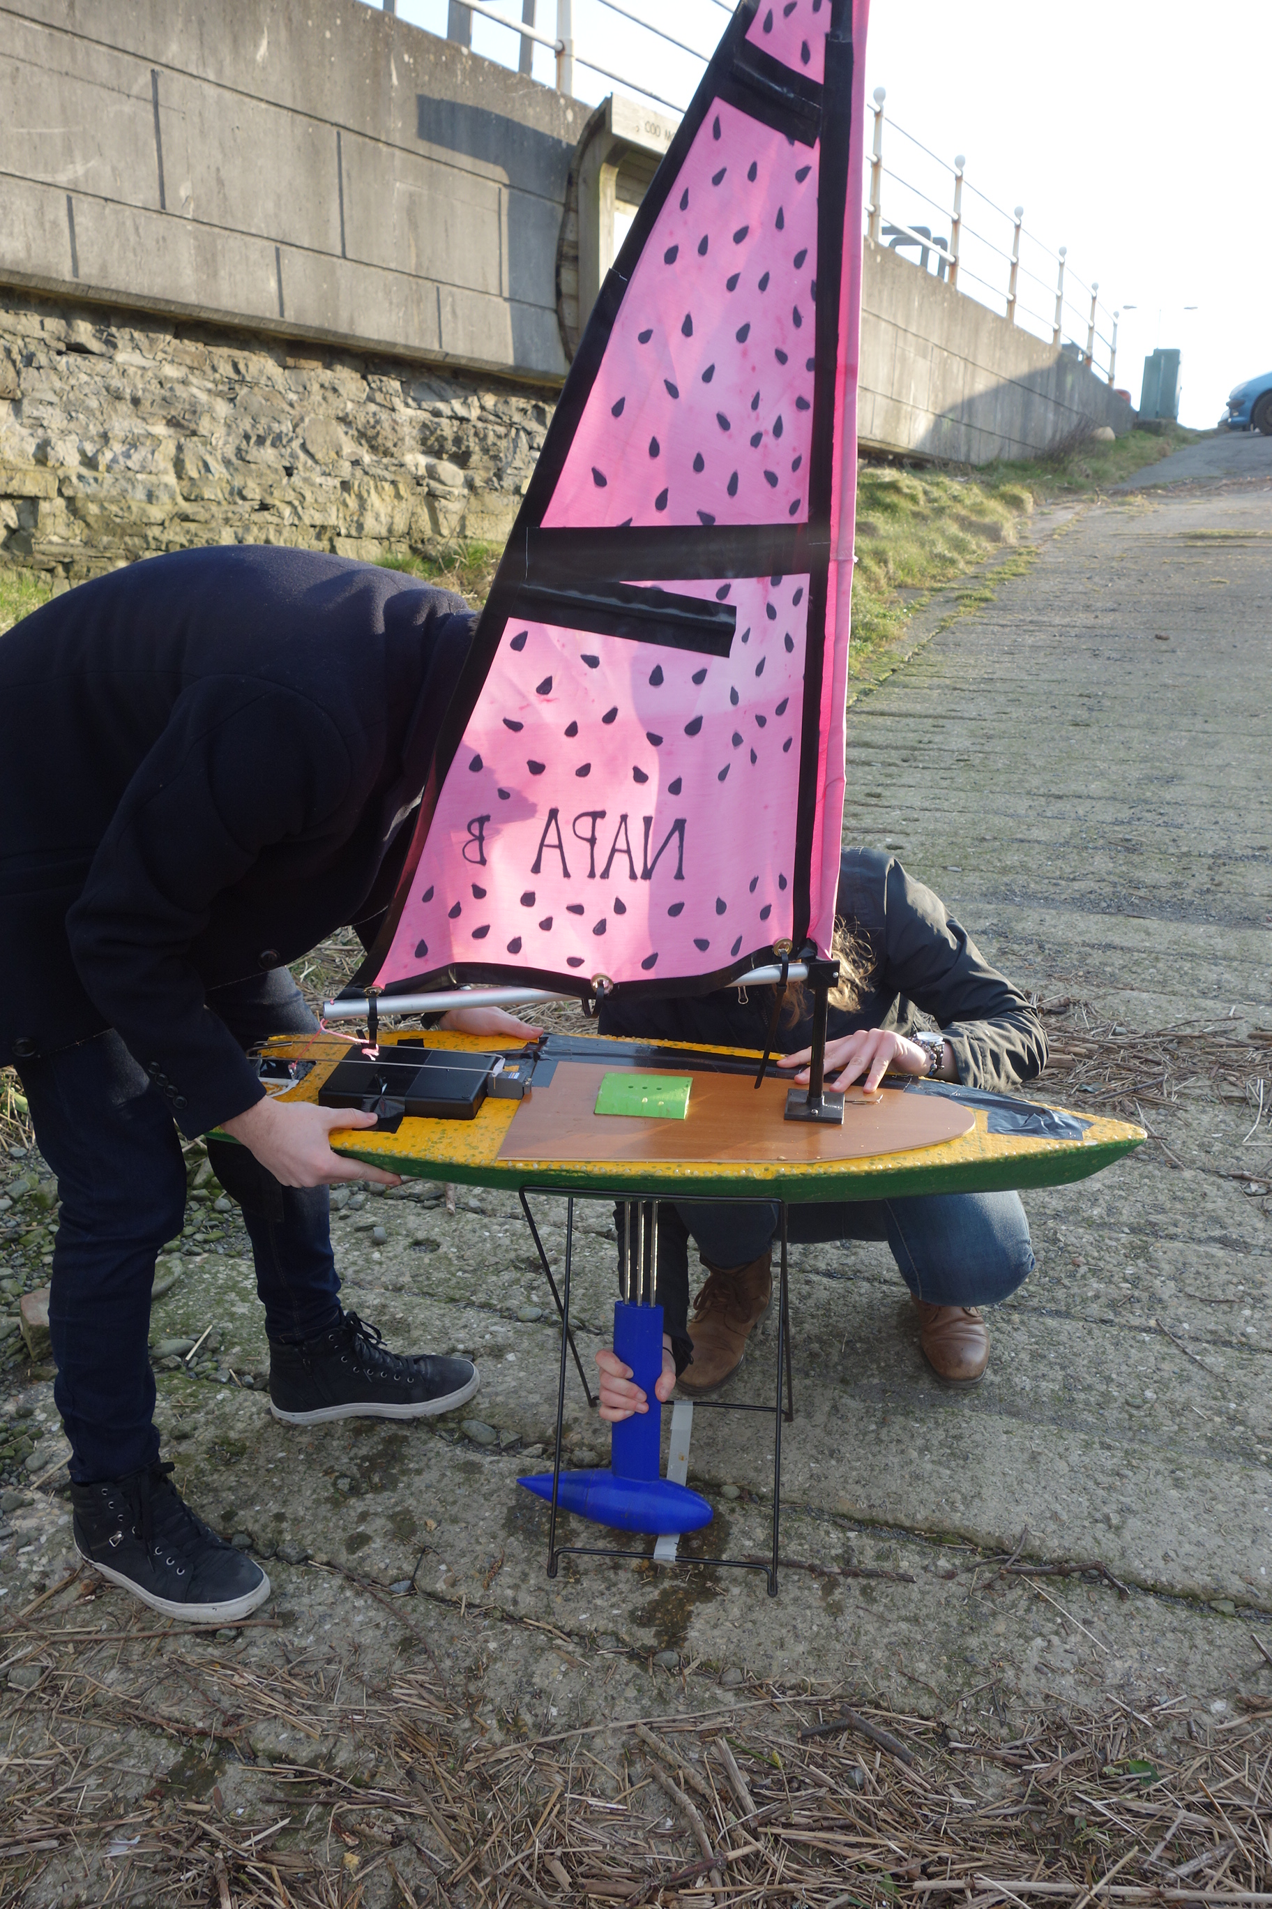
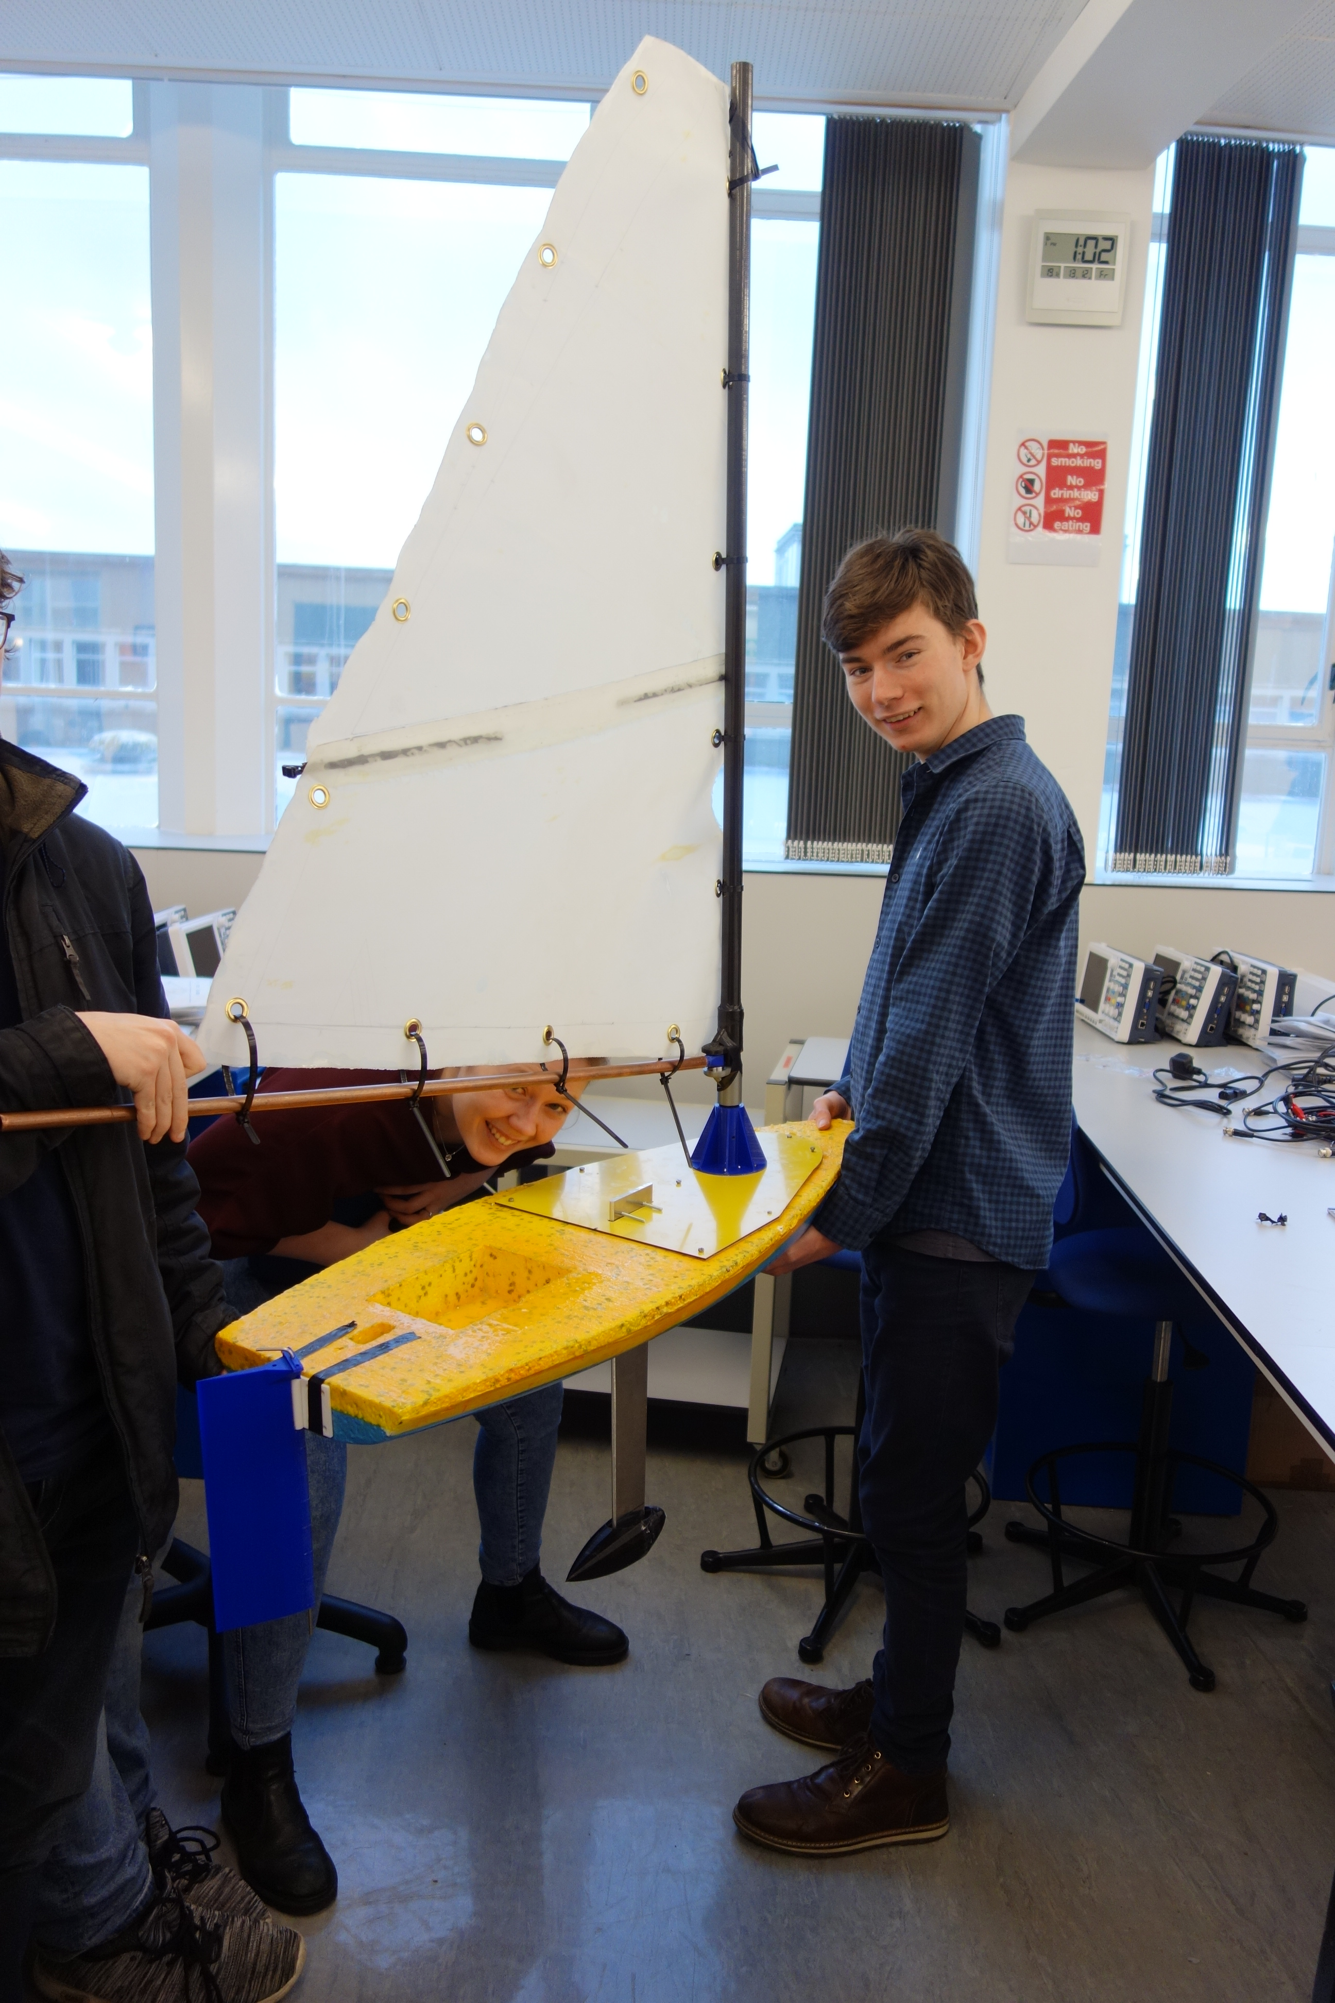
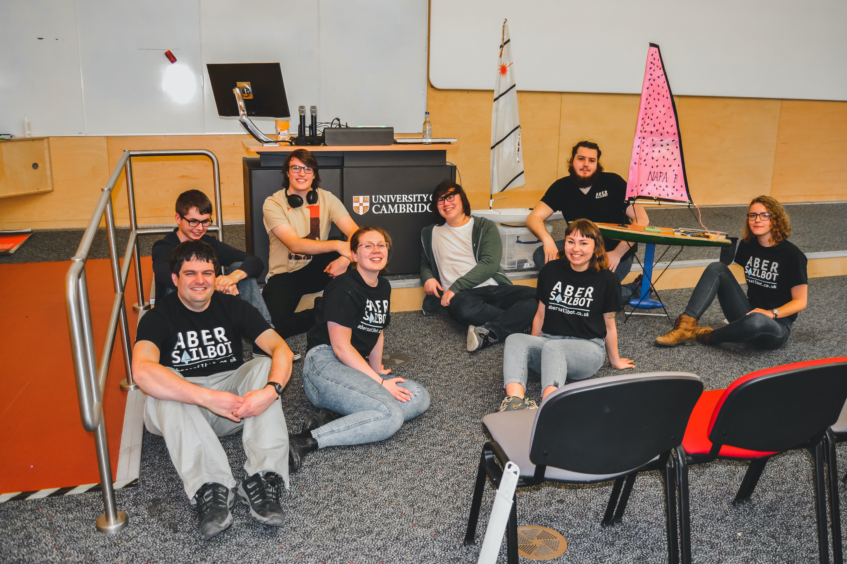
Polystyrene Boats
fb.com/abersailbot @abersailbot sailbot@aber.ac.uk
Notes:
Dewi’r Ddraig
Facts
Main and Jib
Maxi-MOOP hull - Paul Miller
1.2M, not the fastest, strong wind
Stable & reliable
New
Wind Sensor - dept design (rotary encoder)
Handle
Storm Sails
Electronics…
We have a simulator...
Kitty
Still work to be done
Needs new sail
Boat much larger
Detachable keel

Slide 6
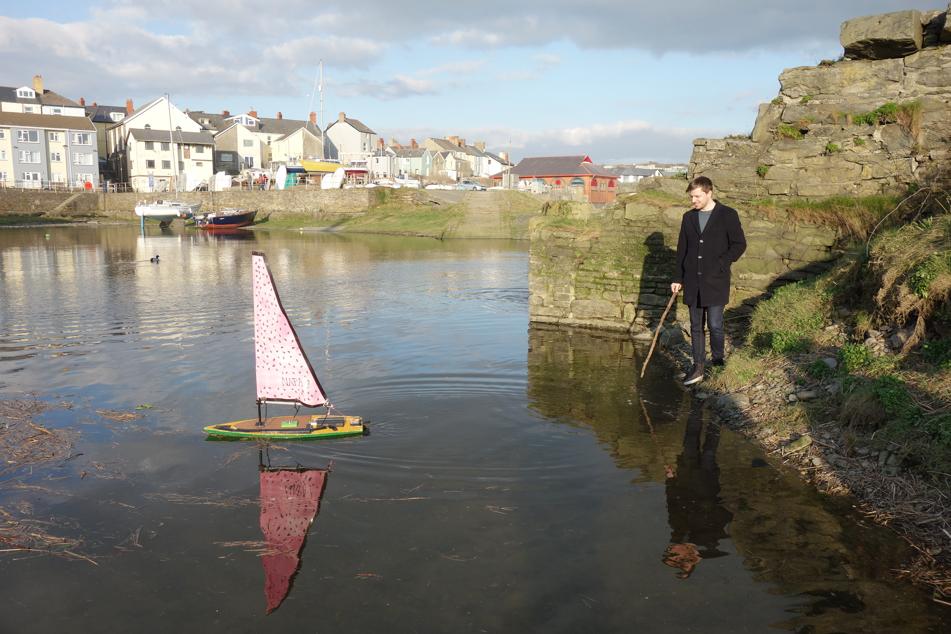
Plan for this year
Virtual Machine Autonomy Challenge
Virtual World Robotic Sailing Championships
Finish polystyrene boats we started last year.
Be ready to return to in person events next year
fb.com/abersailbot @abersailbot sailbot@aber.ac.uk
Notes:
Robotic Boats
RC and Sail Themselves
Code (boatd etc)
Competitions
Microtransat
Not alone - community of people

Slide 7
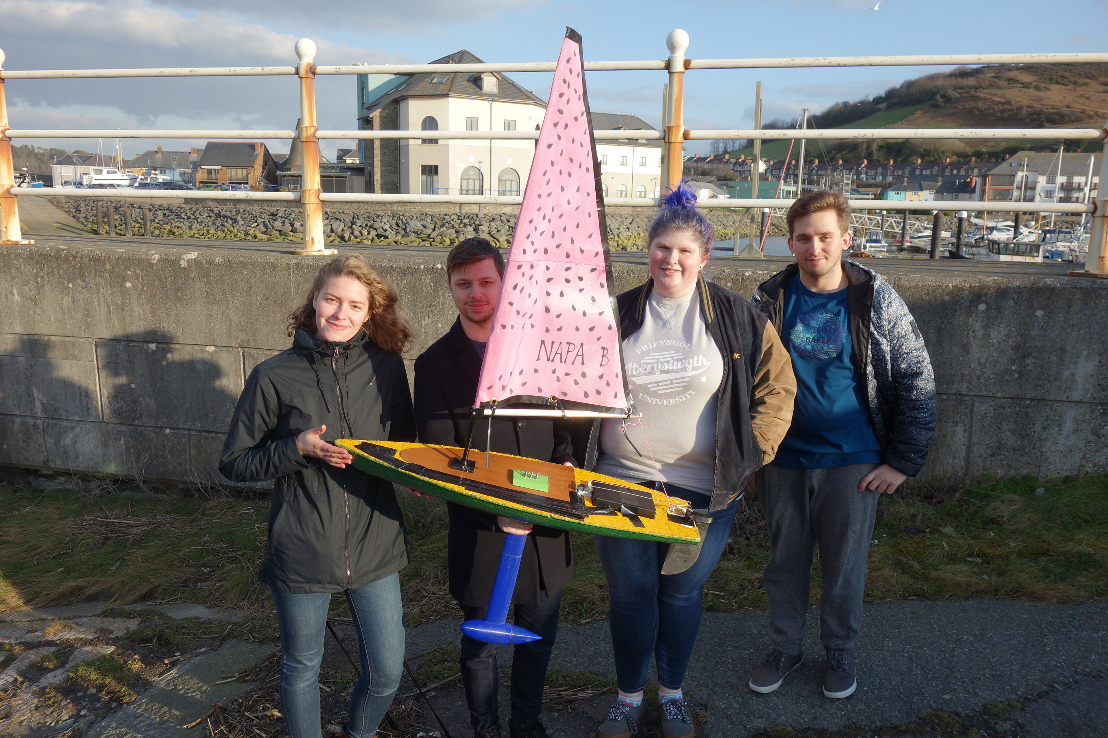
Thanks for Listening!
JOIN US!
abersailbot.co.uk/joinus
fb.com/abersailbot @abersailbot sailbot@aber.ac.uk
Notes:
Fill form (abersailbot.co.uk/joinus)
Give us email in ThinkTank
Facebook Message, Tweet, Email

